Slide 1
N5 Computing Science
Notes:
Python functions: https://docs.python.org/3/library/functions.html

Slide 2
Plan – N5 Year 1
SDD
Software Design and Development (40%)
DDD
Database Design and Development (25%)
WDD
Web Design and Development (25%)
Computer Systems (10%)
C/Sys
Notes:
Hide as appropriate

Slide 3
Implementation
Python

Slide 4
Thonny
thonny.org

Slide 5
Sharepoint

Slide 6
Learning Intentions
Describe and use internal commentary

Slide 7
Internal Commentary
Use internal commentary in all programs
As a minimum:
1 # Title: My First Program
2 # Author: Mr Friend
3 # Date: 27 October 2025
Ignored by computer
Hash symbol (comment)
Line numbers
Notes:
Helps to tell the 'story' of what the program does

Slide 8
Internal Commentary
Start all programs with internal commentary
As a minimum:
1 # Title:
2 # Author:
3 # Date:

Slide 9
Learning Intentions
Describe and use output to screen

Slide 10
Display information
1 # Display text
2 print("Hello world")
3
4 # Display a number
5 print(3.14)
Text displayed
Number displayed

Slide 11
Display information
1 # Display text
2 print("Hello world")
3
4 # Display a number
5 print(3.14)
Notes:
After this, internal commentary omitted from slides to save space

Slide 12
Learning Intentions
Describe and identify syntax errors

Slide 13
Syntax Errors
Program will not run until all syntax errors corrected
1 # Display some text
2 print(Hello world")
3
4 # Display a number
5 print(3.14)
Opening quotation mark missing
Unexpected indentation (4 spaces)
Notes:
Often, the line number of the error is where it is spotted not where it is.

Slide 14
Syntax Errors
1 # Display some text
2 print(Hello world")
3
4 # Display a number
5 print(3.14)
Notes:
Often, the line number of the error is where it is spotted not where it is.

Slide 15
Learning Intentions
Describe and use data types

Slide 16
Data type – Character
A single character
A letter – "a", "z", "G"
A number – "0", "7"
A symbol – "!", ";", "@"
All with quotation marks
Notes:
Python also allows single quotation marks: 'abcXYZ'

Slide 17
Data type – Character
A letter – "a", "z", "G"
A number – "0", "7"
A symbol – "!", ";", "@"

Slide 18
Data type – String
A string of characters
Letters – "abcXYZ"
Numbers – "123890"
Symbols – "!£$*()"
Mixture – "Hello 2 u !!!!"
All with quotation marks
Notes:
Python also allows single quotation marks: 'abcXYZ'

Slide 19
Data type – String
Letters – "abcXYZ"
Numbers – "123890"
Symbols – "!£$*()"
Mixture – "Hello 2 u !!!!"

Slide 20
Data type – Integer
Whole numbers
Positive and negative
–9999
0
3

Slide 21
Data type – Integer
–9999
0
3

Slide 22
Data type – Real
Decimal numbers
Positive and negative
–99·999
0·0
3·14
Also known as ‘Floating point’

Slide 23
Data type – Real
–99·999
0·0
3·14

Slide 24
Data type – Boolean
Binary choice
True or False
Can be used to represent:
Yes / No
On / Off
1 / 0

Slide 25
Data type – Boolean
Can be used to represent:

Slide 26
Data types
Type | Description | Examples
Character | A single character | "a", "1", "@"
String | A string of characters | "Hello", "01871"
Integer | Whole numbers | 3, -99, 0
Real | Decimal numbers | 3·14, -99·6, 0·0
Boolean | Binary – two states | True / False

Slide 27
Data types
Type | Description | Examples
 |  | "a", "1", "@"
 |  | "Hello", "01871"
 |  | 3, -99, 0
 |  | 3·14, -99·6, 0·0
 |  | True / False

Slide 28
Learning Intentions
Assign values in a program

Slide 29

What is a variable?
Somewhere to store information
Has a name
Can be thought of as a box
Can only store 1 piece of info

Slide 30

How do they work?
Store 11 in variable1
Copy variable1 to variable2
Variable created, with a name
Value stored in it
11
11
variable1
variable2

Slide 31
What is it?
=
Maths: equals sign
This is computing, not maths!
(is the same as)
Computing: assignment operator
(is assigned the value )

Slide 32
What is it?
=
Maths:
Computing:

Slide 33
Assignment – variable
Value assigned
to variable
Variable name
Value to be stored
age = 18
Assignment operator
Notes:
A single value.

Slide 34
Assignment – variable
age = 18

Slide 35
Spot the Variables
name
"name"
"date"
date
length
"length"
weight
"weight"
height
"height"
Strings have quotation marks, variable do not!
Notes:
Class: Markup strings with ink

Slide 36
Spot the Variables
name
"name"
"date"
date
length
"length"
weight
"weight"
height
"height"

Slide 37
Spot the Numbers
"999"
999
3.14
"3.14"
-0.03
"-0.03"
17.5
"17.5"
"42"
42
Strings have quotation marks, numbers do not!
Notes:
Class: Markup strings with ink

Slide 38
Spot the Numbers
"999"
999
3.14
"3.14"
-0.03
"-0.03"
17.5
"17.5"
"42"
42

Slide 39
Trace table
word1 | word2
1 word1 = "Hello"
2 word2 = "world"
3 word1 = "What?"
4 word1 = "Bye"
5 word2 = "all!"
"Hello"
"world"
"What?"
"Bye"
"all!"
Notes:
Not part of N5 but useful for clearing up misconceptions about variables
When a variable is overwritten there is no history of the previous value – obliterated!

Slide 40
Trace Table
word1 | word2
1 word1 = "Hello"
2 word2 = "world"
3 word1 = "What?"
4 word1 = "Bye"
5 word2 = "all!"

Slide 41
Display Variables
1 text = "Hello world"
2 print(text)
3
4 age = 17
5 print(age)
Variable name
Variable name

Slide 42
Display Variables
1 text = "Hello world"
2 print(text)
3
4 age = 17
5 print(age)

Slide 43
Learning Intentions
Describe and use meaningful identifiers

Slide 44
Variable names – Rules
Start with a letter
Only contain letters, numbers, underscores
No spaces
Unique
Examples
height cost
age number_2 number1

Slide 45
Variable names – Rules
Examples

Slide 46
Variable names – Conventions
Camel case
Meaningful
Singular (not plural)
Examples
pupilAge costPerKilo kgs2lbs
petName examGrade
Notes:
Camel case – lower case with humps
Use singular for variable names
Uppercase letters used for constants: PI = 3·14

Slide 47
Variable names – Conventions
Examples

Slide 48
Learning Intentions
Describe and use arithmetic operations

Slide 49
Arithmetic Operators
Problem
Result
+ Add
– Subtract
* Multiply
/ Divide
** Power of
3 + 7 = 10
9 – 4 = 5
2 * 3 = 6
8 / 4 = 2.0
3 ** 2 = 9
Notes:
Python division always results in a real value
Task. Create variables & display result: add = 3 + 7 print(add) powerOf = 3**2 print(powerOf)

Slide 50
Arithmetic Operators
Problem
Result
Add
Subtract
Multiply
Divide
Power of
3 =
9 =
2 =
8 =
3 =

Slide 51
Learning Intentions
Describe and identify execution errors

Slide 52
Execution Errors
Program will run but then stop (crash)
1 print("This works!")
2
3 age = 17
4 print(age / 0)
5
6 number = "2"
7 print(number + 2)
Division by zero
Incompatible data types
String
Integer

Slide 53
Execution Errors
1 print("This works!")
2
3 age = 17
4 print(age / 0)
5
6 number = "2"
7 print(number + 2)

Slide 54
Learning Intentions
Describe and use the predefined functions

Slide 55
Function – Example
Parentheses
print("Hello world")
Function name
Parameter(s)
Function name and parentheses required
Parameters can be optional
Notes:
Decimal places can be omitted: round(6·23) → 6

Slide 56
Function – Example
print("Hello world")
Notes:
Decimal places can be omitted: round(6·23) → 6

Slide 57
Functions – Overview (1)
Process
Input
Output
A function does 'something'

Slide 58
Functions – Overview (1)

Slide 59
Functions – Overview (2)
Function
(Process)
Input
Output
Wash
Dirty clothes
Clean clothes
Capitalise
"hello"
"Hello"
Add together
7, 2
9

Slide 60
Functions – Overview (2)

Slide 61
Using Functions
1 print("Hello world")
2
3 text = "Hello world"
4 print(text)
Literal used
Variable used

Slide 62
Using Functions
1 print("Hello world")
2
3 text = "Hello world"
4 print(text)

Slide 63
Learning Intentions
Describe and use the predefined function: round

Slide 64
Round (Overview)
Function
Input
Output
Round
to dp
3·1415, 3
3·142
round()
3·1415, 2
3·14
round()
3·1415
3
Input: Real, Integer (optional)
Output: Real / Integer

Slide 65
Round (Overview)
Function
Input
Output
3·1415, 3
3·1415, 2
3·1415
Input:
Output:

Slide 66
round() – Example
Output
myValue =
round(3·1415, 2)
Function
Input
Decimal places can be omitted: round(6·23) → 6
Input to the function can be variables
Notes:
Decimal places can be omitted: round(6·23) → 6

Slide 67
round() – Example
myValue =
round(3·1415, 2)
Decimal places can be omitted: round(6·23) →
Input to the function can be
Notes:
Decimal places can be omitted: round(6·23) → 6
Python rounds 0·5 to the nearest even number: round(6·5) → 6

Slide 68
Rounding to an Integer (Python)
Integer
Integer
x ·1 ·2 ·3 ·4 ·5 ·6 ·7 ·8 ·9 x+1
?
round(3.5)
→ 4
round(4.5)
→ 4
Tied: rounds to nearest even integer
Notes:
Specific to Python

Slide 69
Rounding to an Integer (Python)
x ·1 ·2 ·3 ·4 ·5 ·6 ·7 ·8 ·9 x+1

Slide 70
Learning Intentions
Describe and use string concatenation

Slide 71
Joining words together
Hello
world
Notes:
Humans join words together to make meaning / sense

Slide 72
Joining strings together - concatenation
"Hello"
+
"world"
Notes:
Using a computer, strings can be joined together to make meaning / sense
“Glues” together

Slide 73
Concatenation Example
word1 | word2
"Hello"
1 word1 = "Hello"
2 word2 = "world"
3
4 text = word1 + word2
5 text = word1 + " " + word2
6 print(text)
"world"
Concatenate
text
"Helloworld"
"Hello world"
Concatenate
Notes:
Could add a space at the end of "Hello " or at the beginning of " world".

Slide 74
Concatenation Example
word1 | word2
1 word1 = "Hello"
2 word2 = "world"
3 text = word1 + word2
4 text = word1 + " " + word2
5 print(text)
text

Slide 75
Concatenation
Joins
strings
together
Not integers, real, or Boolean values
Notes:
What about other data types?

Slide 76
Concatenation

Slide 77
Learning Intentions
Describe and use casting to a string
Notes:
Not part of N5 specification but needed for concatention

Slide 78
Cast (convert) to String
Function
Input
Output
Cast to string
42
"42"
str()
3.14
"3.14"
str()
True
"True"
Input: Non-string
Output: String

Slide 79
Cast (convert) to String
Function
Input
Output
Input:
Output:

Slide 80
str() - Example
Output
myString =
str(42)
Function
Input
Casts non-string to string
Input can be a variable

Slide 81
str() - Example
myString =
str(42)

Slide 82
Python Example – Casting
word1 | num1
"Height:"
1 word1 = "Height:"
2 num1 = 1.56
3
4 text = word1 +
5
6 print(text)
1.56
text
" " +
str(num1)
"Height: 1.56"
Cast to string
Notes:
Could add a space at the end of "Hello " or at the beginning of " world", but poor

Slide 83
Python Example – Casting
word1 | num1
"Height:"
1 word1 = "Height:"
2 num1 = 1.56
3
4 text = word1 +
5
6 print(text)
"1.56"
text
"Height: 1.56"

Slide 84
Learning Intentions
Describe and use keyboard input
Notes:
Not part of N5 specification but need: input( ), int( ), float( ), str( )
Could use eval( ) for numbers but don't

Slide 85
User input
Function
Input
Output
Get user input
"Enter name"
"Tom"
"Enter pi"
input()
"3.14"
input()
"Enter age"
"17"
Input: String (optional)
Output: String

Slide 86
User input
Function
Input
Output
Input:
Output:

Slide 87
input() – Example
input( ) function
Output
name = input("What is your name? ")
Displayed on the screen (optional)
Everything from the keyboard is a string!
Notes:
Computer waits for user input from the keyboard. Whatever is entered is a string, no matter what it looks like, i.e. if the user enters 42 it is not a number but a string.

Slide 88
input() – Example
name = input("What is your name? ")

Slide 89
Python Example – input()
value1 | value2
1 value1 = input("1st: ")
2 value2 = input("2nd: ")
3 result = value1 + value2
4 print(result)
result
Everything from the keyboard is a string!
Notes:
https://whiteboard.fi/
1. Run through with strings : "Big" + "dog" = "Bigdog"
2. Run through with ‘integers’: "4" + "2" = "42"

Slide 90
Python Example – input()
value1 | value2
1 value1 = input("1st: ")
2 value2 = input("2nd: ")
3 result = value1 +
4 print(result)
result

Slide 91
Learning Intentions
Describe and use casting to a number
Notes:
Not part of N5 specification but need: input( ), int( ), float( )
Could use eval( ) for numbers but don't

Slide 92
Cast (convert) to Integer
Function
Input
Output
Cast to integer
"42"
42
int()
"0"
0
int()
"-9"
-9
Input: String
Output: Integer

Slide 93
Cast (convert) to Integer
Function
Input
Output
Input:
Output:

Slide 94
int() - Example
Output
myInteger =
int("42")
Function
Input
Converts string to integer
Input can be a variable

Slide 95
int() - Example
myInteger =
int("42")

Slide 96
Cast (convert) to Real
Function
Input
Output
Cast to real
"4.2"
4.2
float()
"0"
0.0
float()
"-9.6"
-9.6
Input: String
Output: Real

Slide 97
Cast (convert) to Real
Function
Input
Output
Input:
Output:

Slide 98
float() - Example
Output
myReal =
float("4.2")
Function
Input
Converts string to real
Input can be a variable

Slide 99
float() - Example
myReal =
float("4.2")

Slide 100
Using Multiple Functions
Function 1
Function 2
Input
Output / Input
Output
input()
"17"
int()
"Age?"
17
input()
"3.14"
float()
"Pi?"
3.14
Output of one function = input of the next function

Slide 101
Using Multiple Functions
Function 1
Function 2
Input
Output / Input
Output

Slide 102
input() & int() - Example
Output 1 /
Input 2
Output 2
age =
int( )
input("Age? ")
Function 2
Input 1
Function 1

Slide 103
input() & int() - Example
age =
int( )
input("Age? ")

Slide 104
Python Example – Functions
value1 | value2
1 value1 = int(input("1st: "))
2 value2 = int(input("2nd: "))
3 result = value1 + value2
4 print(result)
result
Notes:
Run through with integers: 4 + 2 = 6

Slide 105
Python Example – Functions
value1 | value2
1 value1 = (input("1st: "))
2 value2 = int(input("2nd: "))
3 result = value1 +
4 print(result)
result

Slide 106
Learning Intentions
Describe and use:
Python shell
print
input
Notes:
????

Slide 107
Learning Intentions
Describe and use:
meaningful identifiers
internal commentary
white space
indentation
Notes:
Indentation covered later

Slide 108
Readability
1 cow = 5
2 sea = 3
3 bob = sea + cow
4 print("Sum: " + str(bob))
1 value1 = 5
2 value2 = 3
3 total = value1 + value2
4 print("Sum: " + str(total))
1. Meaningful identifiers
Notes:
Code is to store two values, add them together, and display the result

Slide 109
Readability
1 cow = 5
2 sea = 3
3 bob = sea + cow
4 print("Sum: " + str(bob))
1 # Store two values
2 value1 = 5
3 value2 = 3
4 # Calculate the total
5 total = value1 + value2
6 # Display the result
7 print(Sum: " + str(total))
1. Meaningful identifiers
2. Internal commentary

Slide 110
Readability
1 cow = 5
2 sea = 3
3 bob = sea + cow
4 print("Sum: " + str(bob))
1 # Store two values
2 value1 = 5
3 value2 = 3
4
5 # Calculate the sum
6 total = value1 + value2
7
8 # Display the result
9 print("Sum: " + str(total))
1. Meaningful identifiers
2. Internal commentary
3. White space
4. Indentation (not shown)
Notes:
Initial: Very poor Final: Much better
Python forces indentation to be used – no example shown

Slide 111
Readability
1 cow = 5
2 sea = 3
3 bob = sea + cow
4 print("Sum: " + str(bob))
1 # Store two values
2 value1 = 5
3 value2 = 3
4
5 # Calculate the sum
6 total = value1 + value2
7
8 # Display the result
9 print("Sum: " + str(total))
Notes:
Initial: Very poor Final: Much better
Python forces indentation to be used – no example shown

Slide 112
Program Layout - Example
TAD
Initialise variables – correct datatype(s)
Get values from user – assign, cast if necessary
Use values from user – assign, cast if necessary
Display results – concatenate, cast if necessary
Notes:
3: Input, 4: Process, 5: Output

Slide 113
Program Layout - Example
TAD
Initialise
Get values
Use values
Display

Slide 114
Learning Intentions
Describe and use fixed loops

Slide 115
Sequences
Stop – Start: Number of values
Start value
range(1, 5)
1, 2, 3, 4
range( ) function
Stop value
range(5)
0, 1, 2, 3, 4
All values
are integers
Stop value (starts at 0)
Last value: Stop - 1
Notes:
If a start value isn’t specified, then it’s 0 (zero).
Info only: list(range(1, 10)) → [1, 2, 3, 4, 5, 6, 7, 8, 9]

Slide 116
Sequences
range(1, 5)
range(5)
Notes:
If a start value isn’t specified, then it’s 0 (zero).
Info only: list(range(1, 10)) → [1, 2, 3, 4, 5, 6, 7, 8, 9]

Slide 117
Fixed Loop – Start Value
Start value
Colon
Loop variable
1 for counter in range(1, 5):
2
3 print(counter)
4
5 print("Finished!")
Code to be repeated indented
Notes:
Keywords: for, in
Function: range( )
If a start value isn’t specified, then it’s 0 (zero).

Slide 118
Fixed Loop – Start Value
1 for counter in range(1, 5):
2
3 print(counter)
4
5 print("Finished!")
Notes:
Keywords: for, in
Function: range( )
If a start value isn’t specified, then it’s 0 (zero).

Slide 119
Fixed Loop – No Start Value
Colon
Loop variable
1 for number in range(5):
2
3 print(number + 1)
4
5 print("Finished!")
Code to be repeated indented
Notes:
Keywords: for, in
Function: range( )
If a start value isn’t specified, then it’s 0 (zero).

Slide 120
Fixed Loop – No Start Value
1 for number in range(5):
2
3 print(number + 1)
4
5 print("Finished!")
Notes:
Keywords: for, in
Function: range( )
If a start value isn’t specified, then it’s 0 (zero).

Slide 121
Learning Intentions
Describe and use:
meaningful identifiers
internal commentary
white space
indentation

Slide 122
Indentation
Colon
spaces at the start of a line
indicates a block of code
Python: very important
Python: follows a colon
1 for counter in range(1, 6):
2
3 # Count value
4 print(counter)
5
6 # Squared
7 print(counter ** 2)
8
9 print("All done!")
Code block
Code block end
(Not indented)

Slide 123
Indentation
spaces at the
indicates a
Python:
Python: follows
1 for counter in range(1, 6):
2
3 # Count value
4 print(counter)
5
6 # Squared
7 print(counter ** 2)
8
9 print("All done!")

Slide 124
Learning Intentions
Describe and use a standard algorithm for a running total within a loop

Slide 125
Running total (Fixed Loop)
Add multiple values together in a loop
1 value = 0
2 total = 0
3
4 for counter in range(4):
5
6 value = int(input("Value: "))
7
8 total = total + value
Initialise variables
How many values to add
Get new value
Add to total
Notes:
Use trace table

Slide 126
Running total (Fixed Loop)
1 value = 0
2 total = 0
3
4 for counter in range(4):
5
6 value = int(input("Value: "))
7
8 total = total + value
Notes:
Use trace table

Slide 127
Learning Intentions
Describe and use normal test data in a test table
Describe and identify syntax, execution, and logic errors

Slide 128
Error Types
Syntax – program won't run / compile
Execution – program stops running
Logic – executes but wrong result – hardest to find
Notes:
Syntax: Print("Hello)
Execution: 2 + "2"

Slide 129
Error Types
Syntax –
Execution –
Logic –

Slide 130
Normal Test Data
Normal – values that are expected
Test Data – selected before testing
Expected output – what should be produced
Actual output – what is produced
Normal
Simulate a die: -2, -1, 0, 1, 2, 3, 4, 5, 6, 7, 8 , 9
Notes:
Normal: 1-6

Slide 131
Normal Test Data
Normal –
Test Data –
Expected output –
Actual output –
Simulate a die: -2, -1, 0, 1, 2, 3, 4, 5, 6, 7, 8 , 9

Slide 132
Test table – Normal
Problem: add two values
Test data | Test type | Expected | Actual | Comment
2, 2 | Normal | 4 | 4 | Pass
2, 3 | Normal | 5 | 6 | Fail
2, 10 | Normal | 12 | 20 | Fail
Do this before writing code
Do this when running tests
Iterate until it passes all the tests!
Notes:
Test table layout is not fixed- amend as necessary
https://n5-sdd-normal-testing.esafriend1r.repl.co/

Slide 133
Test table – Normal
Problem: add two values
Test data | Test type | Expected | Actual | Comment
 | Normal
 | Normal
 | Normal

Slide 134
Test table – Normal - Practise
Problem:
Test data | Test type | Expected | Actual | Comment

Slide 135
Learning Intentions
Describe and use simple conditions

Slide 136
Boolean
True
1
On
Yes
False
0
Off
No

Slide 137
Boolean

Slide 138
Comparison Operators
/ Relational Operators
==
>
>=
<
<=
!=
Equality, the same
Greater than
Greater than or equal to
Less than
Less than or equal to
Inequality, not the same

Slide 139
Comparison Operators
==
>
>=
<
<=
!=

Slide 140
True or False?
5 == 5
5 < 3
6 != 9
89 >= 89
val1 = 7.5 val2 = 7.5
val1 == val2
"A" == "a"
True != False
True
False
True
True
True
False
True
Notes:
Use Thonny shell / console

Slide 141
True or False?
5 == 5
5 < 3
6 != 9
89 >= 89
val1 = 7.5 val2 = 7.5
val1 == val2
"A" == "a"
True != False

Slide 142
Learning Intentions
Describe and use selection with simple conditions

Slide 143
Decisions
If your eyes are blue, raise your hand
If your hair is dark, put a finger on your nose
If the test is True, do something
If the test is False, do nothing

Slide 144
if – Single Selection
Example 1
Example 2
1 2 3 4 5 6 7 | number = 5 if number > 0: # True # Do this # Always do
1 2 3 4 5 6 7 | number = -5 if number > 0: # True # Do this # Always do
True
False

Slide 145
if – Single Selection
1 2 3 4 5 6 7 | number = 5 if number > 0: # True # Do this # Always do
1 2 3 4 5 6 7 | number = -5 if number > 0: # True # Do this # Always do

Slide 146
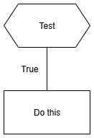
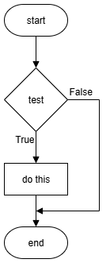
Design – if
Structure diagram
Flowchart
if
if

Slide 147
Design – if
Structure diagram
Flowchart

Slide 148
Learning Intentions
Describe and use selection with simple conditions

Slide 149
Decisions
If your eyes are blue, raise your hand
Otherwise, put a finger on your nose
If your hair is dark, put a finger on your nose
Otherwise, raise your hand
If the test is True, do something
If the test is False, do something else

Slide 150
if, else – Double Selection
Example 1
Example 2
1 number = 5
2
3 if number == 5:
4 # True
5
6 else:
7 # False
1 number = -5
2
3 if number == 5: 4 # True
5
6 else:
7 # False
True
False

Slide 151
if, else – Double Selection
1 number = 5
2
3 if number == 5:
4 # True
5
6 else:
7 # False
1 number = -5
2
3 if number == 5: 4 # True
5
6 else:
7 # False

Slide 152
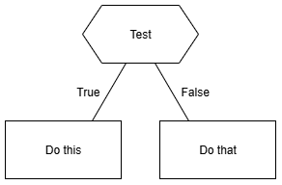
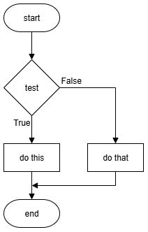
Design – if, else
Structure diagram
Flowchart
if
else
if
else

Slide 153
Design – if, else
Structure diagram
Flowchart

Slide 154
Learning Intentions
Describe and use selection with simple conditions

Slide 155
Nested if – Multiple Selection
1 number = int(input("Enter a whole number: "))
2
3 if number > 0:
4 # True
5
6 else:
7 if number < 0:
8 # True
9
10 else:
11 # False
Tests done in order
Multiple nested
ifs allowed
Nested if
(inside else)
else not mandatory

Slide 156
Nested if – Multiple Selection
1 number = int(input("Enter a whole number: "))
2
3 if number > 0:
4 # True
5
6 else:
7 if number < 0:
8 # True
9
10 else:
11 # False

Slide 157
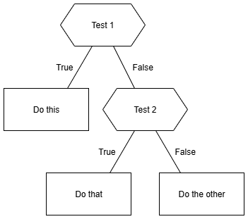
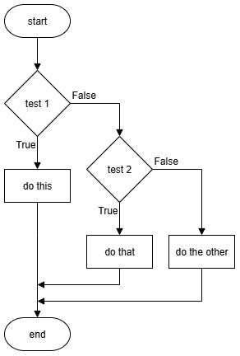
Design – Nested if
else is optional
Structure diagram
Flowchart
if
if
Nested if
Nested if
else
else

Slide 158
Design – Nested if
Structure diagram
Flowchart

Slide 159
Learning Intentions
Describe and use the predefined function: length

Slide 160
Length – String (Overview)
Function
Input
Output
Count
Characters
"Hello"
5
len()
"C@t"
3
len()
"17"
2
Input: String
Output: Integer

Slide 161
Length – String (Overview)
Function
Input
Output
Input:
Output:

Slide 162
len() – String – Example
Output
myValue =
len("Hello")
Function
Input
Counts the characters
Input to the function can be a variable

Slide 163
len() – String – Example
myValue =
len("Hello")
Counts the
Input to the function can be a

Slide 164
Learning Intentions
Describe and use selection with simple conditions

Slide 165
if, else if, else – Multiple Selection
1 number = int(input("Enter a whole number: "))
2
3 if number > 0:
4 # True
5
6 elif number < 0:
7 # True
8
9 else:
10 # False
Tests done in order
Multiple elif allowed
else is optional

Slide 166
if, else if, else – Multiple Selection
1 number = int(input("Enter a whole number: "))
2
3 if number > 0:
4 # True
5
6 elif number < 0:
7 # True
8
9 else:
10 # False

Slide 167
Design – if, elif, else
else is optional
Structure diagram
Flowchart
if
if
else if
else if
else
else

Slide 168
Design – if, else if, else
Structure diagram
Flowchart

Slide 169
else if – Tip
1 number = int(input("Enter a whole number: "))
2
3 if number > 0:
4 # True
5
6 elif number < 0:
7 # True
8
9 else:
10 # False
Tests done in order
Multiple elif allowed
else is optional
Notes:
0-2 Too young, 3-4 Nursery, 5-11 Primary, 12-18 Secondary, 19+ Too old

Slide 170
Learning Intentions
Describe and use extreme test data in a test table
Describe and identify execution and logic errors
Notes:
Extreme – at the limits / edge

Slide 171
Extreme Test Data
Extreme – at limit of selection – either side
1 number = int(input("Number: "))
2
3 if number < 0:
4 print("Negative")
Line 1 | Number:
Line 3 | Boolean:
-2 -1 0 1 2
Notes:
Add: T T F F F
Mark: extreme values

Slide 172
Extreme Test Data
Extreme – at limit of selection – either side
1 number = int(input("Number: "))
2
3 if number < 0:
4 print("Negative")
Line 1 | Number:
Line 3 | Boolean:

Slide 173
Test table – Extreme
Problem: Determine if an integer bigger than 10
Test data | Test type | Expected | Actual | Comment
5 | Normal | False | False | Pass
10 | Extreme | False | True | Fail
11 | Extreme | True | True | Pass
Do this before writing code
Do this when running tests
Iterate until it passes all the tests!

Slide 174
Test table – Extreme
Problem: integer bigger than 10?
Test data | Test type | Expected | Actual | Comment
 | Normal
 | Extreme
 | Extreme

Slide 175
Learning Intentions
Describe and use logical operators (AND, OR, NOT)

Slide 176
AND – Logical Operator
Condition 1 | Condition 2 | Overall
False | False | False
False | True | False
True | False | False
True | True | True
All conditions must be True!

Slide 177
AND – Logical Operator
Condition 1 | Condition 2 | Overall

Slide 178
AND – True or False?
False
5 < 2 AND 9 > 3
3 > 1 AND 8 > 4
8 > 7 AND 6 < 2
89 >= 98 AND 8 == 9
17 != 17 AND 17 == 17
"A" != "a" AND "B" > "A"
False
True
False
False
False
True
True
True
True
False
If first condition is
False
all others ignored!
False
False
True
True
Notes:
If first condition is False, all other conditions are ignored.

Slide 179
AND – True or False?
5 < 2 AND 9 > 3
3 > 1 AND 8 > 4
8 > 7 AND 6 < 2
89 >= 98 AND 8 == 9
17 != 17 AND 17 == 17
"A" != "a" AND "B" > "A"

Slide 180
OR – Logical Operator
Condition 1 | Condition 2 | Overall
False | False | False
False | True | True
True | False | True
True | True | True
One or more conditions must be True!

Slide 181
OR – Logical Operator
Condition 1 | Condition 2 | Overall

Slide 182
OR – True or False?
True
3 > 1 OR 8 > 4
7 > 8 OR 2 < 6
89 >= 98 OR 8 == 9
17 != 17 OR 17 == 17
"A" == "a" OR "B" > "A"
True
True
False
True
True
False
True
If first condition is
True
all others ignored!
False
False
False
True
False
True
Notes:
If first condition is True, all other conditions are ignored.

Slide 183
OR – True or False?
3 > 1 OR 8 > 4
7 > 8 OR 2 < 6
89 >= 98 OR 8 == 9
17 != 17 OR 17 == 17
"A" == "a" OR "B" > "A"

Slide 184
NOT – Logical Operator
Condition | Overall
False | True
True | False
Opposites!

Slide 185
NOT – Logical Operator
Condition | Overall

Slide 186
NOT – True or False?
False
NOT ( 5 < 2 )
NOT ( 3 > 1 AND 4 > 8 )
NOT ( 8 > 9 OR 6 <= 6 )
True
True
False
True
False
False
True

Slide 187
NOT – True or False?
NOT ( 5 < 2 )
NOT ( 3 > 1 AND 4 > 8 )
NOT ( 8 > 9 OR 6 <= 6 )

Slide 188
Learning Intentions
Describe and use extreme test data in a test table
Describe and identify execution and logic errors
Notes:
Extreme – at the limits / edge

Slide 189
Extreme Test Data
Extreme – normal test data but at limit of:
acceptable values
decisions (selection) – either side
Normal
Simulate a die: -2, -1, 0, 1, 2, 3, 4, 5, 6, 7, 8 , 9
Extreme

Slide 190
Extreme Test Data
Extreme – normal test data but at limit of:
acceptable values
decisions (selection) – either side
Simulate a die: -2, -1, 0, 1, 2, 3, 4, 5, 6, 7, 8 , 9

Slide 191
Learning Intentions
Describe and use selection with complex conditions
Notes:
No slides

Slide 192
Example 1 – Body Temperature
1 temp = float(input("Body temp (deg C): "))
2
3 if temp >= 36.1 and temp <= 37.2:
4 print("Normal body temperature")
5 else:
6 print("Not normal body temperature")
How many extreme values (1 dp) are needed?
Notes:
Source: https://medlineplus.gov/ency/article/001982.htm
Create test table then implement

Slide 193
Example 2 – Theme Park Ride
1 age = int(input("Age (years): "))
2 height = float(input("Height (metres): "))
3
4 if age >= 10 and height >= 1.2:
5 print("All criteria met")
Create test. Implement. Test.
Notes:
Theme park ride. Minimum age and minimum height restrictions.
Create test table then implement / Supersize with elif, else to shown failed criteria.

Slide 194
Task – Jockeys
Professional jockeys are small and light.
Determine if someone is a potential jockey.
They must have:
Maximum height of 1 metre, i.e. 1.00
Maximum weight of 15 kg, i.e. 15.0
Display some kind words if they're not suitable.
Design user interface. Create tests. Implement. Test.
Notes:
Completely made-up criteria!
Design interface, create test table, implement, test

Slide 195
Learning Intentions
Describe and use efficient selection

Slide 196
Efficient coding (1)
Inefficient
Efficient
Two
tests
One
test
Faster,
Simpler
1 if score >= 60:
2 print("Pass")
3
4 if score < 60:
5 print("Fail")
1 if score >= 60:
2 print("Pass")
3
4 else:
5 print("Fail")

Slide 197
Efficient coding (1)
1 if score >= 60:
2 print("Pass")
3
4 if score < 60:
5 print("Fail")
1 if score >= 60:
2 print("Pass")
3
4 else:
5 print("Fail")

Slide 198
Selection – if, else if, else (3 or more options)
Generic
Python
IF <condition 1> is true THEN
do something
ELSE IF <condition 2> is true THEN
do something else
ELSE
do this instead
END IF
if 5 < 2:
print("True")
elif 5 == 2:
print("Another option")
else:
print("All False")
Else can be omitted

Slide 199
Selection – if, else if, else (3 or more options)
Generic
Python
IF <condition 1> is true THEN
do something
ELSE
do this instead
END IF
if 5 < 2:
print("True")
else:
print("All False")

Slide 200
Efficient coding (2)
Else if (multiple allowed)
Inefficient
Efficient
1 if age >= 67:
2 print("Retired")
3
4 if age >= 18 and age < 67:
5 print("Working aged")
6
7 if age < 18:
8 print("School aged")
1 if age >= 67:
2 print(" Retired")
3
4 elif age >= 18:
5 print("Working aged")
6
7 else:
8 print("School aged")
3 or 4 conditions tested
1 or 2 conditions tested
Notes:
Inefficient: every condition is evaluated, every time
Efficient: at first True condition selection terminates
run through with 20

Slide 201
Efficient coding (2)
1 if age >= 67:
2 print("Retired")
3
4 if age >= 18 and age < 67:
5 print("Working aged")
6
7 if age < 18:
8 print("School aged")
1 if age >= 67:
2 print(" Retired")
3
4 elif age >= 18:
5 print("Working aged")
6
7 else:
8 print("School aged")

Slide 202
Task – SQA Grades
SQA exam results are graded:
A 70-100
B 60-69
C 50-59
D 40-49
No Award 0-39
Assumptions
All values integers
Values will be 0-100
Create a test table first!
Notes:
Create test table then implement

Slide 203
Learning Intentions
Describe and use conditional loops

Slide 204
Conditional Loop
WHILE condition is True DO
something
END WHILE
Code to be repeated
Code is only run if the condition is True
Notes:
Only enter the loop when the condition is True.
Only exit the loop when the condition is False.

Slide 205
Conditional Loop
condition is True DO
END

Slide 206
Conditional Loop
1 number = int(input("Number: "))
2
3
4 while number < 10:
5 number = number + 1
6 print(number)
Keyword
Condition
True
False
Code repeats while the condition is True
Notes:
what happens if <age> is 3, 5, 9 ?
Condition can be complex

Slide 207
Conditional Loop
1 number = int(input("Number: "))
2
3
4 while number < 10:
5 number = number + 1
6 print(number)

Slide 208
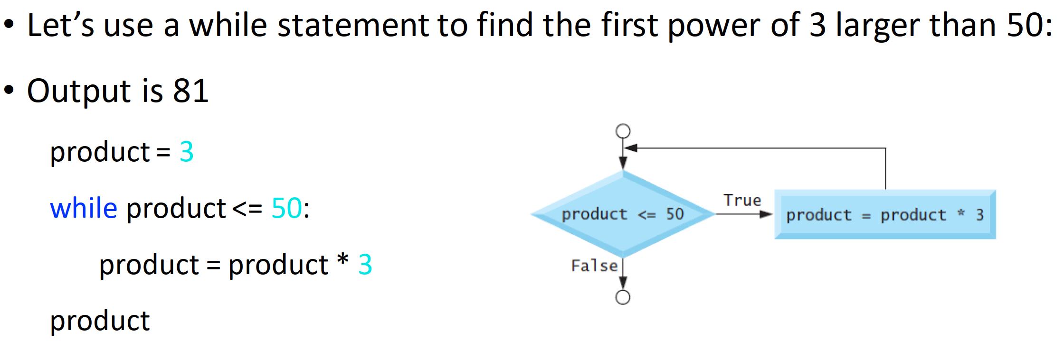
While

Slide 209
Learning Intentions
Describe and use a standard algorithm for input validation
Notes:
Used to limit input values to acceptable values

Slide 210
User input
1 pax = int(input("Passengers: "))
2
3 print("Taxi for " + str(pax))
Notes:
Simple condition

Slide 211
Input validation – Overview
1 Initialise variable used in condition
2 Repeat until condition is FALSE
3 Get input from user
4 Check user input
5 Display error message if needed

Slide 212
Input validation – Overview
1 Initialise variable used in
2 until condition is
3 Get from user
4 user
5 Display , if needed

Slide 213
Input validation – Input before loop
User input
1 pax = int(input("Passengers: "))
2
3 while pax < 1:
4
5 print("Must be at least 1.")
6
7 pax = int(input("Passengers: "))
Must be True to begin
Error message: meaningful
User input
Conditional loop might not be used
Notes:
Simple condition. Error message to be meaningful, i.e. better than "Invalid"
Number of taxi passengers

Slide 214
Input validation – Input before loop
1 pax = int(input("Passengers: "))
2
3 while pax < 1:
4
5 print("Must be at least 1.")
6
7 pax = int(input("Passengers: "))
8

Slide 215
Input validation – Input in loop
Not an acceptable value
Must be True to begin
1 pax = 0
2 while pax < 1:
3
4 pax = int(input("Passengers: "))
5
6 if pax < 1:
7 print("Must be at least 1.")
User input
Error message: meaningful
Conditional loop always used
Notes:
Simple condition. Error message to be meaningful, i.e. better than "Invalid"
Number of taxi passengers

Slide 216
Input validation – Input in loop
1 pax = 0
2 while pax < 1:
3
4 pax = int(input("Passengers: "))
5
6 if pax < 1:
7 print("Must be at least 1.")

Slide 217
Input validation – complex condition
Not an acceptable value
Must be True to begin
1 pax = 0
2 while pax < 1 or pax > 5:
3
4 pax = int(input("Passengers: "))
5
6 if pax < 1 or pax > 5:
7 print("Must be 1 to 5.")
User input
Error message
Notes:
Complex condition. Error message to be meaningful, i.e. better than "Invalid"

Slide 218
Input validation – complex condition
1 pax = 0
2 while pax < 1 or pax > 5:
3
4 pax = int(input("Passengers: "))
5
6 if pax < 1 or pax > 5:
7 print("Must be 1 to 5.")

Slide 219
Input validation – simple string
1 fact = ""
2 while fact != "Computing":
3
4 fact = input("Best subject? ")
5
6 if fact != "Computing":
7 print("Computing is the best!")

Slide 220
Task – Add Input Validation
Add input validation to the following Replit tasks:
N5 SDD Ask Questions – Loops: Min 1
N5 SDD School Days Left – Days: Min 0, Max 190
N5 SDD - Decisions Decisions – Voucher: "yes" or "no"
Notes:
Input validation
Efficient selection

Slide 221
Task – University Degree Classifications
Degrees are given classifications:
First 70-100
2-1 60-69
2-2 50-59
Third 40-49
Fail 0-39
Assumptions
All values integers
Create a test table first!
Notes:
Input validation
Efficient selection

Slide 222
Learning Intentions
Describe and use a standard algorithm for a running total within a loop

Slide 223
Running total (Fixed loop)
1 value = 0
2 total = 0
3
4 for counter in range(4):
5
6 value = int(input("Value? "))
7 total = total + value
Notes:
Revision

Slide 224
Running total (Conditional Loop)
Not an acceptable value
1 answer = ""
2 value, total = 0, 0
3
4 while answer != "no":
5 value = int(input("Value? "))
6 total = total + value
7
8 answer = input("Again? ")
Python shorthand (Don't use!)
Notes:
Loops until condition is false

Slide 225
Running total (Conditional Loop)
1 answer = ""
2 value, total = 0, 0
3
4 while answer != "no":
5 value = int(input("Value? "))
6 total = total + value
7
8 answer = input("Again? ")

Slide 226
Learning Intentions
Describe and use exceptional test data in a test table
Describe and identify syntax, execution, and logic errors
Notes:
Exceptional – beyond the limits / not acceptable

Slide 227
Exceptional Test Data
Exceptional – values that are not acceptable
Normal
Simulate a die: -2, -1, 0, 1, 2, 3, 4, 5, 6, 7, 8 , 9
Extreme
Exceptional
Exceptional

Slide 228
Exceptional Test Data
Exceptional – values that
Simulate a die: -2, -1, 0, 1, 2, 3, 4, 5, 6, 7, 8 , 9

Slide 229
Test table – Exceptional
Problem: Accept integers that are 1 or more
Test data | Test type | Expected | Actual | Comment
5 | Normal | Accept | Accept | Pass
1 | Extreme | Accept | Accept | Pass
0 | Exceptional | Reject | Accept | Fail
Do this before writing code
Do this when running tests
Iterate until it passes all the tests!
Notes:
Test table layout is not fixed - amend as necessary

Slide 230
Test table – Exceptional
Problem: Accept integers that are 1 or more
Test data | Test type | Expected | Actual | Comment
 | Normal
 | Extreme
 | Exceptional

Slide 231
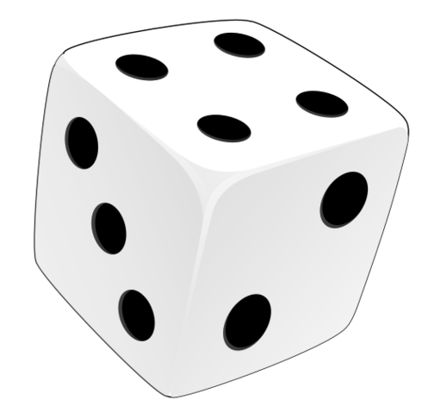
Conditional Loop – Testing
Enter the loop – exceptional test
Stay in the loop – exceptional test (if appropriate)
Exit the loop – extreme test
Test Data | Test Type | Expected | Actual | Comment
3 | Normal | Accepted
6 | Extreme | Accepted
0 | Exceptional | Error message |  | Enter
7 | Exceptional | Error message |  | Stay in
1 | Extreme | Accepted |  | Exit
Notes:
Value of a die

Slide 232
Conditional Loop – Testing
Test Data | Test Type | Expected | Actual | Comment
3 | Normal | Accepted
6 | Extreme | Accepted
0 | Exceptional | Error message |  | Enter
7 | Exceptional | Error message |  | Stay in
1 | Extreme | Accepted |  | Exit

Slide 233
Learning Intentions
Describe and use the 1-D array data structure
Notes:
Not a data type but a data structure

Slide 234
Variables – How many are needed?
A postcode
The ages of 5 pupils
Rainfall for every day of a year
postcode = "HS9 5XD"
age1 = 11
age2 = 14
age3 = 13
age4 = 14
age5 = 12
365 or 366 variables!
Multiple variables are inefficient

Slide 235
Multiple variables → An array
age1 = 11
age2 = 14
age3 = 13
age4 = 14
age5 = 12
[ , , , , ]
11
14
13
14
12
An array is a collection of values of the same datatype

Slide 236
Multiple variables → An array
age1 = 11
age2 = 14
age3 = 13
age4 = 14
age5 = 12
11
14
13
[ , , , , ]
14
12

Slide 237
Assignment – array
Array assigned
to variable
Array name
Values to be stored
ages = [11, 14, 13, 14, 12]
Assignment operator
Values are same data type. Plural used for array names.

Slide 238
Assignment – array
ages = [11, 14, 13, 14, 12]

Slide 239
Array elements / index
Elements
ages = [11, 14, 13, 14, 12]
Index value:
0
1
2
3
4
An array is a data structure

Slide 240
Array elements / index
ages = [11, 14, 13, 14, 12]

Slide 241
Python Example – Access Elements
0 1 2 3 4
1 ages = [11, 14, 15, 14, 13]
2 print(ages)
3
4 age = ages[1]
5 print(age)
6
7 old = ages[3] + 10
8 print(old)
Subscript operator
Index

Slide 242
Python Example – Access Elements
1 ages = [11, 14, 15, 14, 13]
2 print(ages)
3
4 age = ages[1]
5 print(age)
6
7 old = ages[3] + 10
8 print(old)

Slide 243
Python Example – Replace Elements
1 names = [""] * 4
2 print(names)
3
4 names[2] = "Tom"
5 names[0] = "Emma"
6
7 print(names)
Python shorthand
(Do use!)
Index

Slide 244
Python Example – Replace Elements
1 names = [""] * 4
2 print(names)
3
4 names[2] = "Tom"
5 names[0] = "Emma"
6
7 print(names)

Slide 245
Say What You See!
["Hip", "Hip"]

Slide 246
Learning Intentions
Describe and use the predefined function: length

Slide 247
Length – Array (Overview)
Function
Input
Output
Count
Elements
[1, 5, 9, 0]
4
len()
["In","At","Pi"]
3
len()
[True, False]
2
Input: Array
Output: Integer

Slide 248
Length – Array (Overview)
Function
Input
Output
[1, 5, 9, 0]
["In","At","Pi"]
[True, False]
Input:
Output:

Slide 249
len() – Array – Example
Output
myValue =
len([1, 5, 9])
Function
Input
Counts the elements
Input to the function can be a variable

Slide 250
len() – Array – Example
myValue =
len([1, 5, 9])
Counts the
Input to the function can be a

Slide 251
Learning Intentions
Describe and use a standard algorithm for traversing a 1-D array

Slide 252
Traversing an array – Data in
1 ages = [0] * 5
2
3 for index in range(5):
4 age = int(input("Age? "))
5 ages[index] = age
Loop for 5 values
Loop variable
Get value
Assign to array

Slide 253
Traversing an array – Data in
1 ages = [0] * 5
2
3 for index in range(5):
4 age = int(input("Age? "))
5 ages[index] = age

Slide 254
Traversing an array – Data out (1)
1 ages = [11, 14, 13, 14, 12]
2
3 for index in range(len(ages)):
4 print(ages[index])
Loops for each element in array – Displays one at a time

Slide 255
Traversing an array – Data out (1)
1 ages = [11, 14, 13, 14, 12]
2
3 for index in range(len(ages)):
4 print(ages[index])
Loops for each element in array –

Slide 256
Traversing an array – Data out (2)
1 ages = [11, 14, 13, 14, 12]
2
3 for age in ages:
4 print(age)
Loops for each element in array – Displays one at a time
Known as For Each

Slide 257
Traversing an array – Data out (2)
1 ages = [11, 14, 13, 14, 12]
2
3 for age in ages:
4 print(age)
Loops for each element in array –

Slide 258
Learning Intentions
Describe and use the predefined function: random

Slide 259
Random (Overview)
Function
Input
Output
Pick random
1, 6
4
randint()
0, 100
72
randint()
85, 115
87
Input: Integers
Output: Integer

Slide 260
Random (Overview)
Function
Input
Output
Pick random
1, 6
randint()
0, 100
randint()
85, 115
Input:
Output:

Slide 261
random – Example
Gets extra code
1 import random
Name of extra code
Output
min
max
2 myValue =
random.randint(1, 6)
Function
Input
randint() is a function in the random module
Input to the function can be variables

Slide 262
random – Example
1 import random
2 myValue =
random.randint(1, 6)
randint() is a function in the
Input to the function can be

Slide 263
random – Testing
71 # Pick a random score
72 score = random.randint(0, 100)
73
74 # NOTE: used for testing logic
75 score = 50
Codetag
Overwrites random value
Comment out when not being used
Delete when finished with

Slide 264
random – Testing
71 # Pick a random score
72 score = random.randint(0, 100)
73
74 # NOTE: used for testing logic
75 score = 50
Comment out when
Delete when

Slide 265
Task – Dice Game
Simulate a dice game
Computer throws a dice
Human throws a dice (only valid values allowed)
Compare: Too high, Same, Too low
Show what computer threw – to prove it's not cheating!
Notes:
Die – singular / Dice – plural

Slide 266
Test data - Summary
Test type | Description
Exceptional | Values to be rejected / crash program
Extreme | Values at the limit of what is acceptable
Normal | All acceptable values
Example: Accept integers from 1 to 10
Test type | Values
Exceptional | 0, 11, -700
Extreme | 1, 10
Normal | 1, 2, 3, 4, 5, 6, 7, 8, 9, 10
Notes:
0, 11, and -700 are rejected.
"five" and 7.3 cause a runtime error as string / float values (outside the scope of N5 & H).

Slide 267
Test data - Summary
Test type | Description
Exceptional | Values to be
Extreme | Values at the
Normal | All
Example: Accept integers from 1 to 10
Test type | Values
Exceptional
Extreme
Normal

Slide 268
Plan – N5 Year 2
SDD
Software Design and Development (54%)
DDD
Database Design and Development (33%)
Assignment (⅓ of marks)
Computer Systems (13%)
C/Sys
Exam (⅔ of marks)
Notes:
Prelim 1 about half way through DDD
Prelim 2 just before assignment

Slide 269
Plan – N5 Year 2
SDD
Software Design and Development (54%)
DDD
Database Design and Development (33%)
Computer Systems (13%)
C/Sys

Slide 270
Assessment
Assignment – 33%
Question Paper – 67%
SDD 67%
DDD 33%
Marks 40
SDD 54%
DDD 33%
Comp Sys 13%
Marks 80
Final grade out of 120
Notes:
Hide as appropriate

Slide 271
Assessment
Assignment – 40 Marks
Question Paper – 80 Marks
Analysis 3 – 6
Design 4 – 8
Implementation 22 – 24
Testing 3 – 6
Evaluation 3 – 6
Computer Systems 0
Analysis 0 – 5
Design 20 – 40
Implementation 16 – 34
Testing 5 – 10
Evaluation 0 – 5
Computer Systems 10 – 14
Final grade out of 120
Notes:
SDD: 0-5, 0-5, 15, 0-5, 0-5

Slide 272
Development methodologies

Slide 273
Learning Intentions
Describe and implement the phases of an iterative development process

Slide 274
Development Phases
Analysis
Design
Implementation
Testing
Documentation
Note:
Phases are different lengths
Evaluation

Slide 275
Development Phases

Slide 276
Development Phases
Analysis
Design
Implementation
Evaluation
Documentation
Testing

Slide 277
Development Phases

Slide 278
Phases Overview
What's wanted?
How to do it
Make it happen!
Does it work?
Write manuals
Does it do what was wanted?

Slide 279
Phases Overview

Slide 280
Phases Overview
Analysis
Design
Implementation
What is wanted?
How will it be done / look like?
Make it happen!
Does it do what was wanted?
Create user and technical guides
Does it work?
Evaluation
Documentation
Testing

Slide 281
Phases Overview
Analysis
Design
Implementation
Evaluation
Documentation
Testing

Slide 282
Iterative Process
Iterative:
Do it again
Improve each time
Analysis
Design
Implementation
Testing
Documentation
Go back to any earlier stage
Evaluation
Notes:
iterative: doing something again (and again), usually to improve it

Slide 283
Iterative Process
Iterative:
Analysis
Design
Implementation
Testing
Documentation
Evaluation

Slide 284
Analysis

Slide 285
Learning Intentions
Identify the purpose and functional requirements of a problem that relates to the design and implementation, in terms of:
inputs
processes
outputs

Slide 286
Purpose
A statement of what the program is supposed to do:
The program is to ask the user for 2 values and display the sum of the values

Slide 287
Purpose
The program is to ask the user for 2 values and display the sum of the values

Slide 288
Functional Requirements
The inputs, processes, and outputs that are required to achieve the purpose of the program
Input(s)
Process(es)
Output(s)
First value
Add first value and second value together
Result of the calculation
Second value
Notes:
Purpose: The program is to ask the user for 2 values and display the sum of the values

Slide 289
Functional Requirements
The inputs, processes, and outputs
Input(s)
Process(es)
Output(s)

Slide 290
Design

Slide 291
Learning Intentions
Identify the data types and structures required for a problem that relates to the implementation at this level.

Slide 292
Learning Intentions
Describe, identify, and be able to read and understand:
structure diagrams
flowcharts
pseudocode
Exemplify and implement one of the above design techniques to design efficient solutions to a problem.

Slide 293
Structure Diagrams
Steps to solve a problem
Process
Loop
Pre-defined
function
Selection

Slide 294
Structure Diagrams
Steps

Slide 295
Structure Diagrams – Example 1
Read top to bottom, left to right
Title / Description
0
Add two values
Initialise variables
Get first value from user
Get second value from user
Add values together
Display result
1
2
3
4
5

Slide 296
Structure Diagrams – Example 1
Read
Get first value from user
Get second value from user
Add values together

Slide 297
Structure Diagrams – Example 2
0
Top to bottom
Left to right
Find the average of 4 numbers
1
2
5
7
Initialise variables
Loop 4 times
Calculate average
Display average
3
4
6
Get number
Add number to total
Round to
1 dp
Notes:
Running total

Slide 298
Structure Diagrams – Example 2
Find the average of 4 numbers
Initialise variables
Calculate average
Display average
Get number
Add number to total
Notes:
Running total

Slide 299
Structure Diagrams – Example 3
0
Top to bottom
Left to right
Determine
Pass / Fail
1
2
3
5
Initialise variables
Get valid mark
Is mark
>= 50?
Display result
Yes
4
Set result to pass
Notes:
Input validation

Slide 300
Structure Diagrams – Example 3
Determine
Pass / Fail
Initialise variables
Get valid mark
Is mark
>= 50?
Display result
Set result to pass
Notes:
Input validation

Slide 301
Structure Diagrams – Example 4
0
Top to bottom
Left to right
Determine
Pass / Fail
1
2
3
5
Initialise variables
Get valid mark
Is mark
>= 50?
Display result
Yes
No
Set result to pass
Set result to
fail
4a
4b
(Only Yes or No, not both)
Notes:
Input validation

Slide 302
Structure Diagrams – Example 4
Determine
Pass / Fail
Initialise variables
Get valid mark
Display result
Set result to pass
Set result to
fail

Slide 303
Learning Intentions
Describe, identify, and be able to read and understand:
structure diagrams
flowcharts
pseudocode
Exemplify and implement one of the above design techniques to design efficient solutions to a problem.

Slide 304
Flowcharts
Begin at start
Follow the arrows
Finish at end
Input /
Output
Initialisation
Flow
Terminal
Connector
Pre-defined
function
Decision
Process

Slide 305
Flowcharts
Begin at
Follow the
Finish at

Slide 306
Flowcharts – Example 1
start
a
b
Declare variables
Get second user value
Display result
Get first user value
Add values together
end
a
b

Slide 307
Flowcharts – Example 1
Get second user value
Get first user value
Add values together

Slide 308
Flowcharts – Example 2
start
a
b
c
counter = 0
value = 0
total = 0
Get value
Add 1
to counter
Display total
"Enter 4 values"
Add value
to total
No
counter
= 4?
end
Yes
a
b
c
Notes:
Running total
Letters to ensure correct flow

Slide 309
Flowcharts – Example 2
start
a
b
c
counter = 0
value = 0
total = 0
Get value
Add 1
to counter
Display total
"Enter 4 values"
Add value
to total
counter
=
end
a
b
c

Slide 310
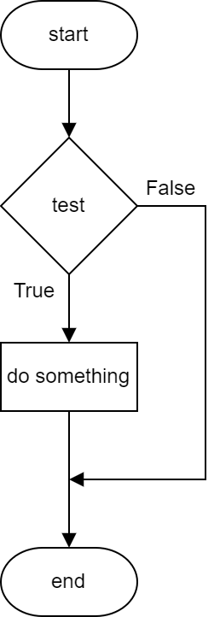
Flowchart – If
1 age = 0
2
3 age = int(input("Age? "))
4
5 if age >= 18:
6 print("Go in")

Slide 311
Flowchart – If
1 age = 0
2
3 age = int(input("Age? "))
4
5 if age >= 18:
6 print("Go in")

Slide 312
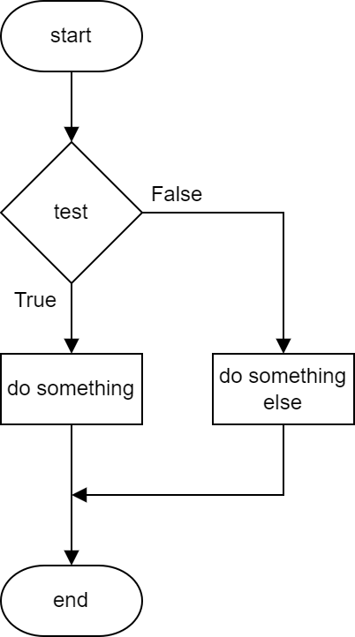
Flowchart – Else
1 age = 0
2
3 age = int(input("Age? "))
4
5 if age >= 18:
6 print("Go in")
7 else:
8 print("Get out!")

Slide 313
Flowchart – Else
1 age = 0
2
3 age = int(input("Age? "))
4
5 if age >= 18:
6 print("Go in")
7 else:
8 print("Get out!")

Slide 314
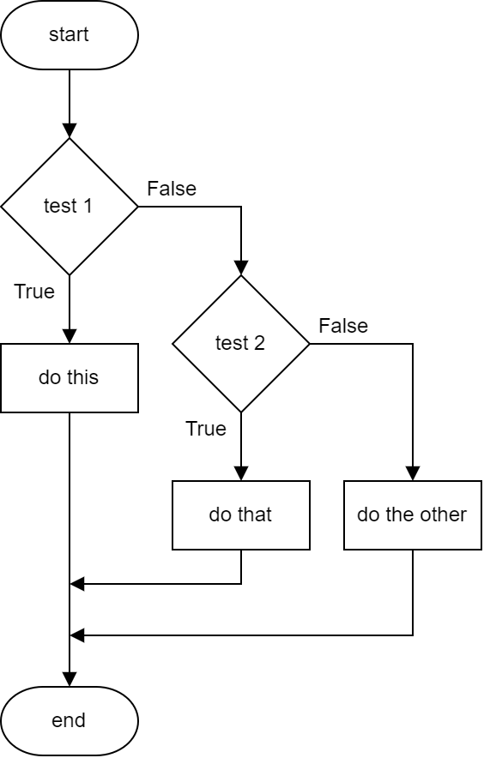
Flowchart – Else If
1 mark = 0
2 mark = int(input("Mark? "))
3 if mark >= 85:
4 print("Distinction")
5 elif mark >= 50:
6 print("Pass")
7 else:
8 print("Fail")

Slide 315
Flowchart – Else If
1 mark = 0
2 mark = int(input("Mark? "))
3 if mark >= 85:
4 print("Distinction")
5 elif mark >= 50:
6 print("Pass")
7 else:
8 print("Fail")

Slide 316
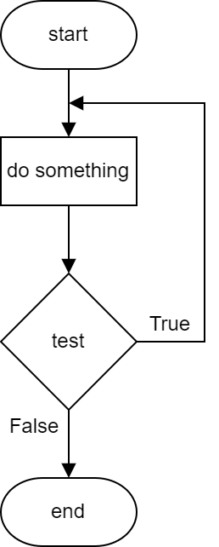
Flowchart – While (Repeat … Until)
1 cost, total, more = 0, 0, ""
2
3 while more != "n":
4 cost = int(input("Cost? "))
5 total = total + cost
6 more = input("More? (y/n)")
7
8 print("Total: " + str(total))

Slide 317
Flowchart – While (Repeat … Until)
1 cost, total, more = 0, 0, ""
2
3 while more != "n":
4 cost = int(input("Cost? "))
5 total = total + cost
6 more = input("More? (y/n)")
7
8 print("Total: " + str(total))

Slide 318
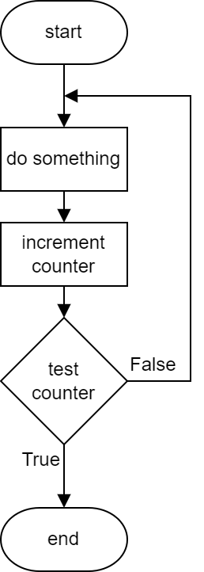
Flowchart – For
1 cost, total = 0, 0
2
3 for index in range(4):
4 cost = int(input("Cost? "))
5 total = total + cost
6
7 print("Total: " + str(total))

Slide 319
Flowchart – For
1 cost, total = 0, 0
2
3 for index in range(4):
4 cost = int(input("Cost? "))
5 total = total + cost
6
7 print("Total: " + str(total))

Slide 320
Learning Intentions
Describe, identify, and be able to read and understand:
structure diagrams
flowcharts
pseudocode
Exemplify and implement one of the above design techniques to design efficient solutions to a problem.

Slide 321
Pseudocode
Written in structured English
Main steps show algorithm
Refinements show detail
SQA Reference Language (SQARL) != Pseudocode

Slide 322
Pseudocode
Written in
Main steps
Refinements
SQA Reference Language (SQARL)

Slide 323
Pseudocode – Example
1 Ask user to enter rectangle dimensions
2 Calculate perimeter
3 Calculate area
4 Display results
1.1 Ask user for length
1.2 Ask user for breadth
3.1 Calculate area: length x breadth
Algorithm
Refinements
Not all refinements shown
Notes:
Calculate perimeter and area of a rectangle

Slide 324
Pseudocode – Example
1 Ask user to enter rectangle dimensions
2 Calculate perimeter
3 Calculate area
4 Display results
1.1 Ask user for length
1.2 Ask user for breadth
3.1 Calculate area: length x breadth

Slide 325
Learning Intentions
Describe, exemplify, and implement user-interface design, in terms of input and output, using a wireframe.
Notes:
S4 pupils, not S3

Slide 326
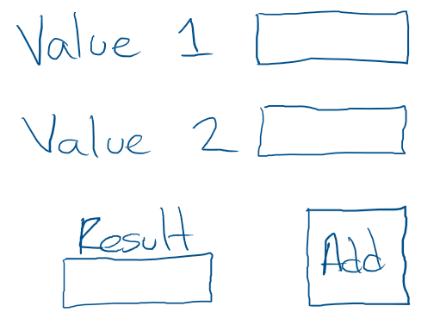
UI Wireframe
Used to show the inputs and outputs
Initially just a sketch
Inputs
Output
Submit
(to processes)
Notes:
Calculate perimeter and area of a rectangle

Slide 327
UI Wireframe
Used to show
Initially just
Notes:
Calculate perimeter and area of a rectangle

Slide 328
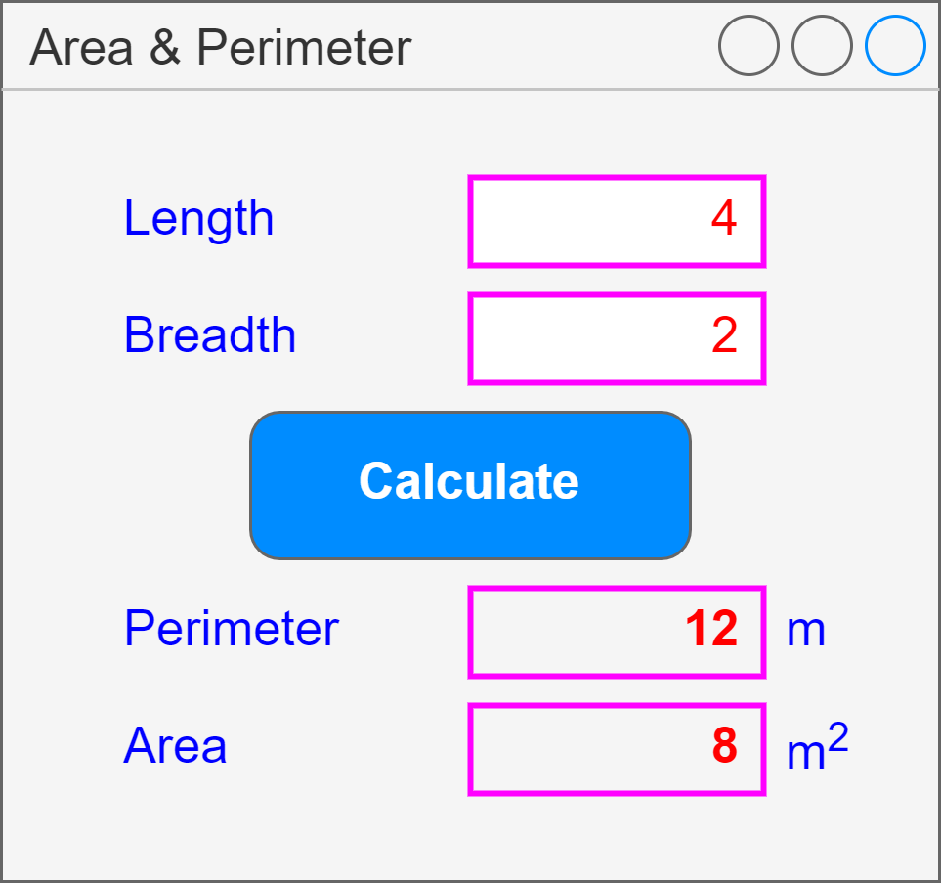
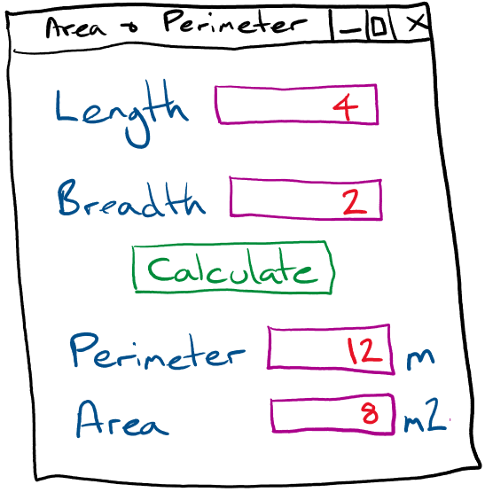
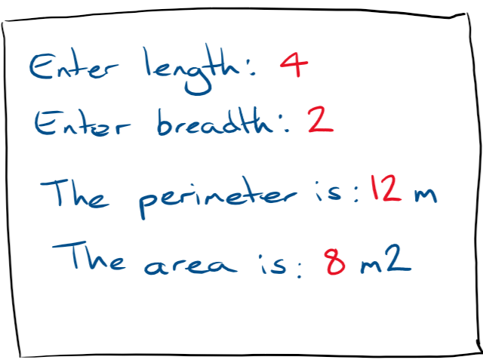
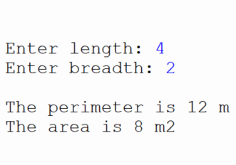
UI Wireframe – Example
App Based
Text Based
Text box
(input)
Inputs
Button
Submit
(process)
Text box
(output)
Outputs
Label
Notes:
Calculate perimeter and area of a rectangle
Use draw.io for app based version
Use Replit to implement text based version

Slide 329
UI Wireframe – Example
Notes:
Calculate perimeter and area of a rectangle
Use draw.io for app based version
Use Replit to implement text based version

Slide 330
Calculator Wireframe
Create a wireframe for a simple calculator app that will only add, subtract, multiply and divide two numbers.

Slide 331
Evaluation

Slide 332
Learning Intentions
Describe, identify, and exemplify the evaluation of a solution in terms of:
fitness for purpose
efficient use of coding constructs
robustness
readability:
internal commentary
meaningful identifiers
indentation
white space

Slide 333
Fitness for Purpose
Comparison of solution (code and testing) with program analysis, not design, and expected output
Does it do the requirements identified during analysis
Assignment: Own code. Justify it!

Slide 334
Fitness for Purpose
Comparison of solution (code and testing) with program
Does it do the requirements

Slide 335
Efficiency
Describe efficiencies or inefficiencies such as
Array vs multiple variables
Nested ifs (else ifs) vs individual ifs
Use of a loop vs repetition of code
Assignment: Own code. Justify it!

Slide 336
Efficiency
Describe
Array
Nested ifs (else ifs)
Use of a loop

Slide 337
Robustness
Input validation (exceptional tests), or lack of it
Potential for errors – possible to enter incorrect values?
How it responds to unexpected data: text instead of number
Assignment: Own code. Justify it!

Slide 338
Robustness
Input validation (exceptional tests)
Potential for errors
How it responds to unexpected data

Slide 339
Internal Commentary
Explains what the code does
Helps clarify complex code
Helps others / future self
Assignment: Own code. Justify it!

Slide 340
Internal Commentary
Explains what
Helps clarify
Helps others

Slide 341
Special Comments
59 # TODO: Display result
74 # BUG: Not calculating correctly
Codetag: Something to be done
Codetag: A problem to be sorted
Reminders of what needs to be done
Notes:
Excellence creep! Works in Thonny.
PEP 350 - https://peps.python.org/pep-0350/

Slide 342
Special Comments
59 # TODO: Display result
74 # BUG: Not calculating correctly

Slide 343
Meaningful Identifiers
Names relate to the data
Names indicate what they do / hold
Assignment: Own code. Justify it!

Slide 344
Meaningful Identifiers
Names
Names indicate what

Slide 345
Indentation
Highlights structures
Assignment: Own code. Justify it!

Slide 346
Indentation

Slide 347
White Space (Blank lines)
Between structures in program
Easier to see sections of code
Assignment: Own code. Justify it!

Slide 348
White Space
Between
Easier to

Slide 349
Learning Intentions
Describe and use internal commentary

Slide 350
Special Comments
59 # TODO: Display result
74 # BUG: Not calculating correctly
Codetag: Something to be done
Codetag: A problem to be sorted
Reminders of what needs to be done
Notes:
Excellence creep!
PEP 350 - https://peps.python.org/pep-0350/

Slide 351
Special Comments
59 # TODO: Display result
74 # BUG: Not calculating correctly

Slide 352
Learning Intentions
Describe and use fixed loops

Slide 353
Sequences
Start value
(inclusive)
range(1, 5)
1, 2, 3, 4
range( ) function
Stop value
(exclusive)
range(5)
0, 1, 2, 3, 4
All values
integers
Stop value (starts at 0)
range(1, 5, 2)
1, 3
Step value
Notes:
If a start value isn’t specified, then it’s 0 (zero).
Info only: list(range(1, 10)) → [1, 2, 3, 4, 5, 6, 7, 8, 9]

Slide 354
Sequences
Start value
range(1, 5)
1, 2, 3, 4
range( ) function
Stop value
range(5)
0, 1, 2, 3, 4
All values
integers
Stop value (starts at 0)
range(1, 5, 2)
1, 3
Step value
Notes:
If a start value isn’t specified, then it’s 0 (zero).
Info only: list(range(1, 10)) → [1, 2, 3, 4, 5, 6, 7, 8, 9]

Slide 355
Sequences
range(1, 5)
1, 2, 3, 4
range(5)
0, 1, 2, 3, 4
range(1, 5, 2)
1, 3

Slide 356
Fixed Loop – Example 1
Colon
Loop variable
1 for counter in range(1, 5):
2 print(counter)
3
4 for number in range(5):
5 print(number)
Code to be repeated indented
Loop variable
Notes:
Keywords: for, in
Function: range( )
If a start value isn’t specified, then it’s 0 (zero).

Slide 357
Fixed Loop – Example 1
1 for counter in range(1, 5):
2 print(counter)
3
4 for number in range(5):
5 print(number)

Slide 358
Fixed Loop – Example 2
Step
1 for value in range(1, 10, 2):
2 print(value)
Start and Stop values required if Step used

Slide 359
Fixed Loop – Example 2
1 for value in range(1, 10, 2):
2 print(value)

Slide 360
Learning Intentions
Describe and use array concatenation

Slide 361
Concatenate – Strings – Revision
1 text = ""
2
3 for counter in range(5):
4 text = text + str(counter)
5
6 print(text)
Empty string
Concatenate
Cast to string
Notes:
Super size: ask how many times to loop (limit 2-5), ask for character to concatenate

Slide 362
Concatenate – Strings – Revision
1 text = ""
2
3 for counter in range(5):
4 text = text + str(counter)
5
6 print(text)

Slide 363
Concatenate – Arrays
1 values = []
2
3 for counter in range(5):
4 values = values + [counter]
5
6 print(values)
Empty array
Concatenate
Cast to array
Notes:
Super size: ask how many times to loop (limit 1-6), ask for dice value (1-6)
Super-super size: display average of dice values

Slide 364
Concatenate – Arrays
1 values = []
2
3 for counter in range(5):
4 values = values + [counter]
5
6 print(values)

